Slide 1
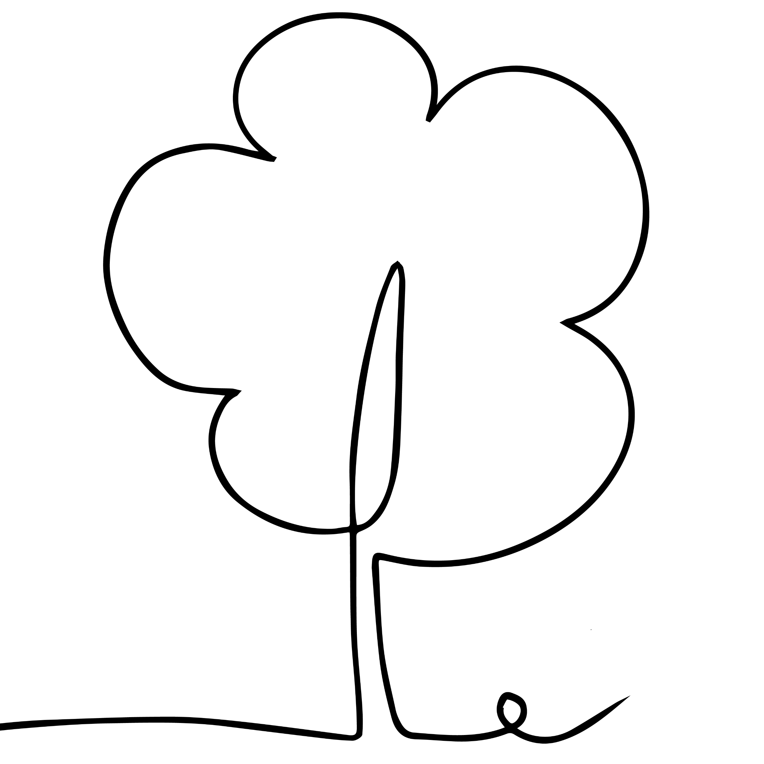
Connect with
Nature this
Mental Health
Awareness Week

